Slide 1
Capstone Project 2019
IOS Team
Use Cases Exploration

Slide 2
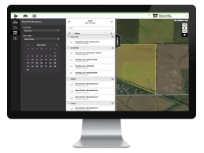
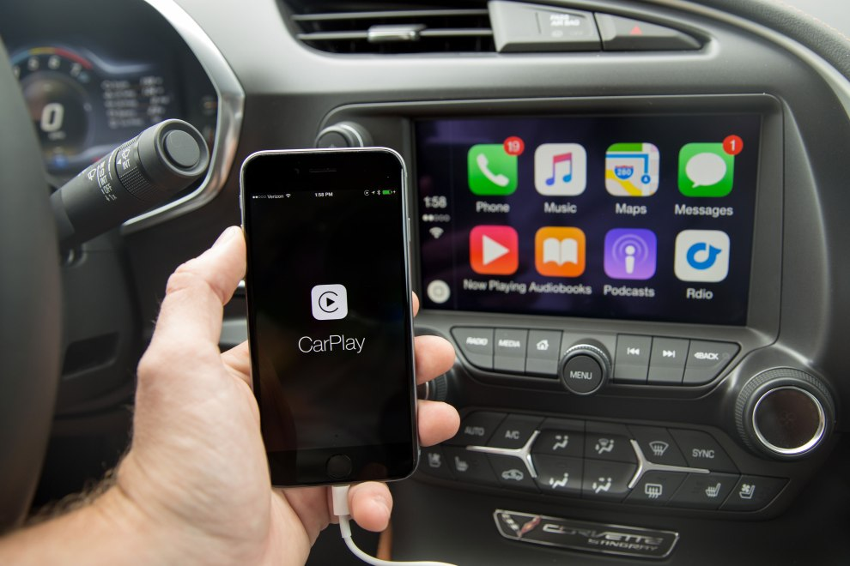
Goal of the project:
Extension of Operator Interface to Apple Car Play

Slide 3
Goal of the project:
JD Driver

Slide 4
Goal of the project:
Which features make the most sense to be made available?
How do the choosen features look and feel?
What does it take?
What have you learned?
What do you suggest?

Slide 5
Who is our user? What is his story?
Progressive Farmer
Our farmer is skilled
He knows his exact plan of work for the day ahead.
Today he is visiting his “Corn” Fields (2 Fields).
While he is driving to his fields in the morning he uses his assistant “JD Driver” to give him an overview of the fields in case there is a necessity to update his schedule for the day.

Slide 6
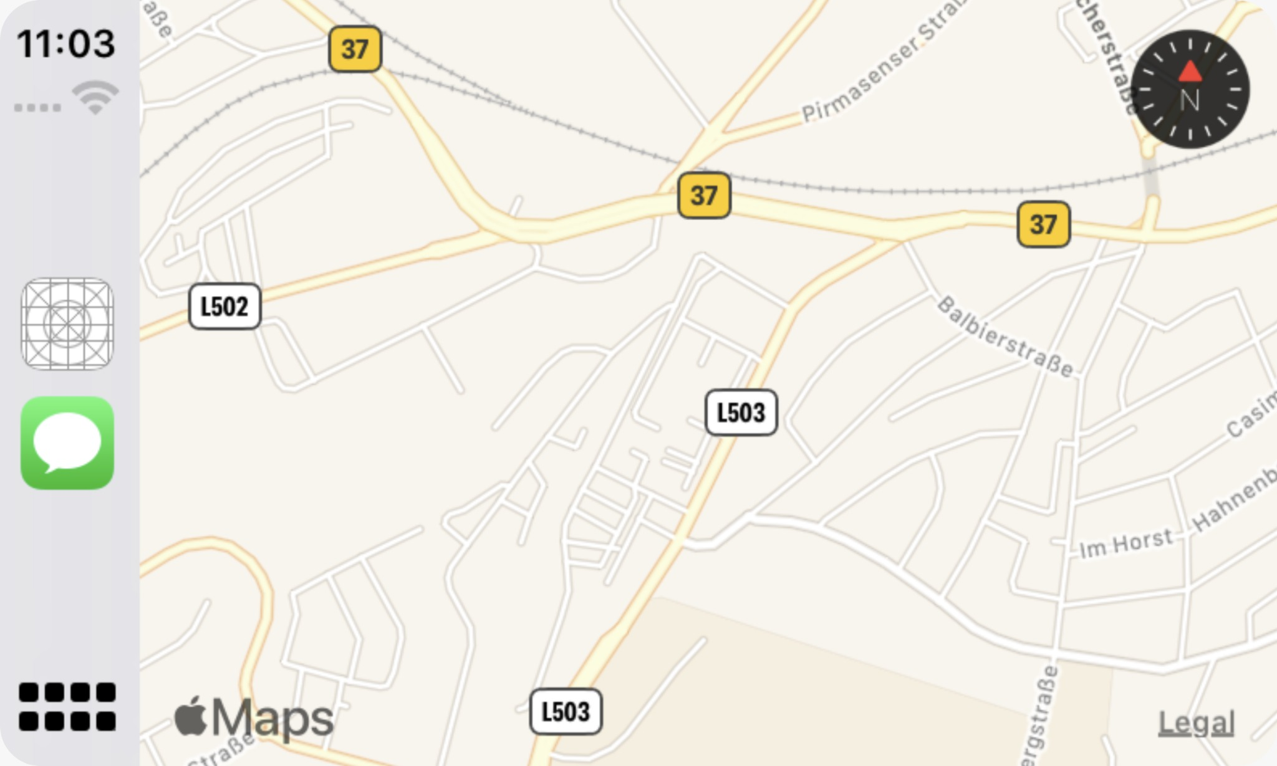



Slide 7
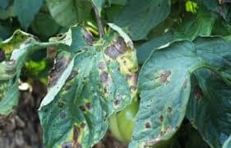

Slide 8
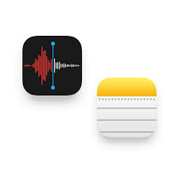
Take a Note (1): Field Related
Context
The farmer is driving nearby his/her “Tomato” field
He notices brown spots on the leafs!!
He can not decide whether its “early blight” or “mites”
He would like to add a note to remind himself to call the agronomist to examine the field

Slide 9
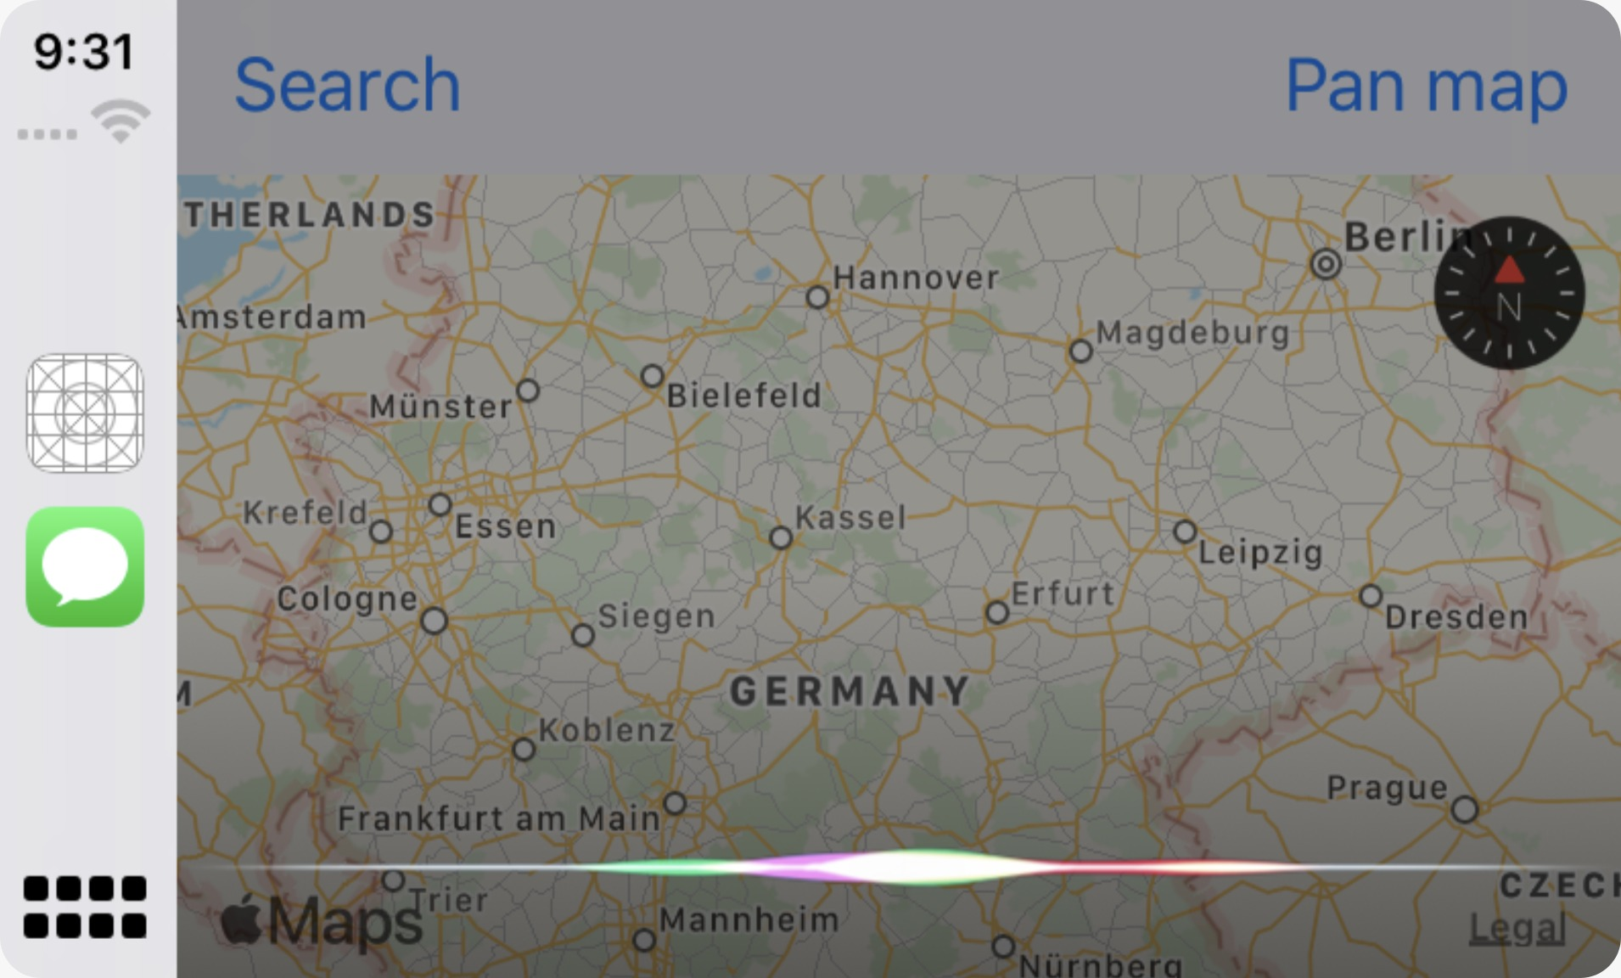

“JD Driver Take a note”

Slide 10
“Ok, Of which type?
General or Field Related?”

Slide 11
“Field Related”

Slide 12
“Ok, For Which Field:
“Potato Field” , “Tomato Field”

Slide 13
“Tomato Field”

Slide 14
“Ok, Tell Me the Note”

Slide 15
“Call The Agronomist to Examine the Field, I Suspect It Has the Mites”

Slide 16
“Ok, This Is Your Note:
“………….”
Do You Want To Save It?”

Slide 17
“Yes!”

Slide 18
“Your Note Has Been Successfully Saved!”

Slide 19
Let’s Try It Out !!

Slide 20

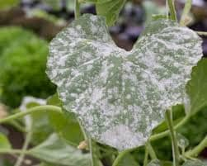
Take a Note (2): General
Context
The farmer is driving back home after his workday
He noticed today that the temperature is rising
He would like to add a note to remind himself/ herself to spray the plants in the greenhouses with “Bavesten” pesticide to prevent “Powdery Miledew”

Slide 21
Let’s Try It Out !!

Slide 23
Get Nearby Fields’ Updates Since Last Visit
Context
The Farmer is driving the car nearby his/her field(s)
He/she wants to have an overview of the current situation (Field Operations , Machine Alerts) of his/her field(s)
Why?
To be able to react quickly by examining the field himself/herself immediately if he/she was nearby or call someone else to react

Slide 24
“JD Driver Give Me Updates”

Slide 25
“Ok, For Which Field ?:
“Potato Field” , “Tomato Field”

Slide 26
“Potato Field”

Slide 27
“Since Your Last Visit on
18.11.2019
…………
”

Slide 28
Let’s Try It Out !!

Slide 30
Get Nearby Fields’ Flags Since Last Visit
Context
The Farmer is driving the car nearby his/her field(s)
He/she wants to have an overview of the current situation of his/her field(s)
Why?
To be able to react quickly by examining the field himself/herself immediately if he/she was nearby or call someone else to react

Slide 31
“JD Driver what are the
Flags?”

Slide 32
“Ok, For Which Field?:
“Potato Field” , “Tomato Field”

Slide 33
“Potato Field”

Slide 34
“Since Your Last Visit on
18.11.2019
…………
”

Slide 35

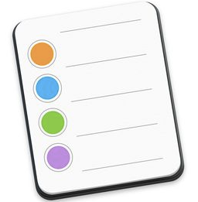
Getting Notes (1): General
Context
The farmer is driving to his organization in the morning
He knows well his schedule for today
But he wants to be reminded if there was something else that he was supposed to do

Slide 36
“JD Driver Tell Me My Notes”

Slide 37
“Ok, Of which type?
General or Field Related?”

Slide 38
“General”

Slide 39
“OK , You Have 2 Reminders, Here They Are:
……..
”

Slide 40
Getting Notes (1): Field Related
Context
The farmer is driving nearby his “Potato” Field
He wants to be reminded of the field related notes in case he has to act upon them

Slide 41
“JD Driver Tell Me My Notes”

Slide 42
“Ok, Of which type?
General or Field Related?”

Slide 43
“Field Related”

Slide 44
“Ok, For Which Field?:
“Potato Field” , “Tomato Field”

Slide 45
“Potato Field”

Slide 46
“OK , You Have 2 Reminders, Here They Are:
……..
”

Slide 47
Goal of the project:
Which features make most sense to be made available?
How do the choosen features look and feel?
What does it take?
What have you learned?
What do you suggest?

Slide 48

What does it take?
Apple Maps
HTTP / REST
JD Driver
Siri

Slide 49
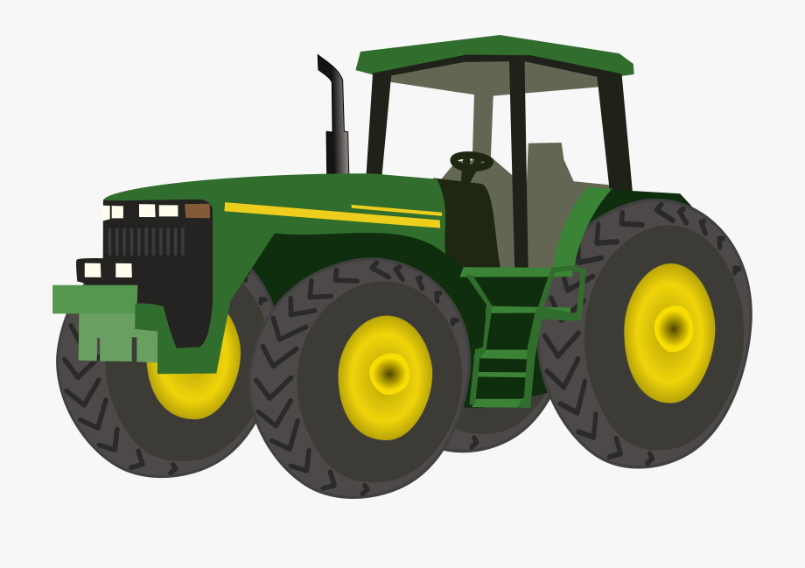
Thank you!

